Slide 1
Daily Scrum
08/03
Da Ye Lee Java A-4 SK Didimdol 4th hillofsky@naver.com

Slide 2
Task List
Assigned Task | Progress
UI 디자인 구현(PPT) | 100%
UI 구현(CSS,JSP) | 0%

Slide 3
Yesterday’s Task
Today’s Task
Technical Issue

Slide 4
1. Yesterday’s Task
What I did?
UI Design
예약 리스트
예약 상세정보
예약 수정

Slide 5
1. Yesterday’s Task
How I did?
UI Design
Airbnb 사이트 조사
숙박예약에 필요한 정보 반영
PPT로 UI Design 작성

Slide 6
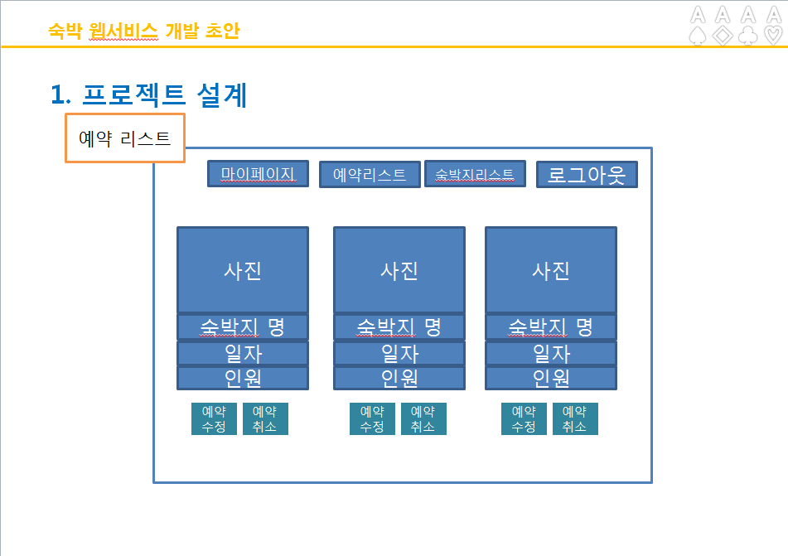
1. Yesterday’s Task
Result
UI Design

Slide 7
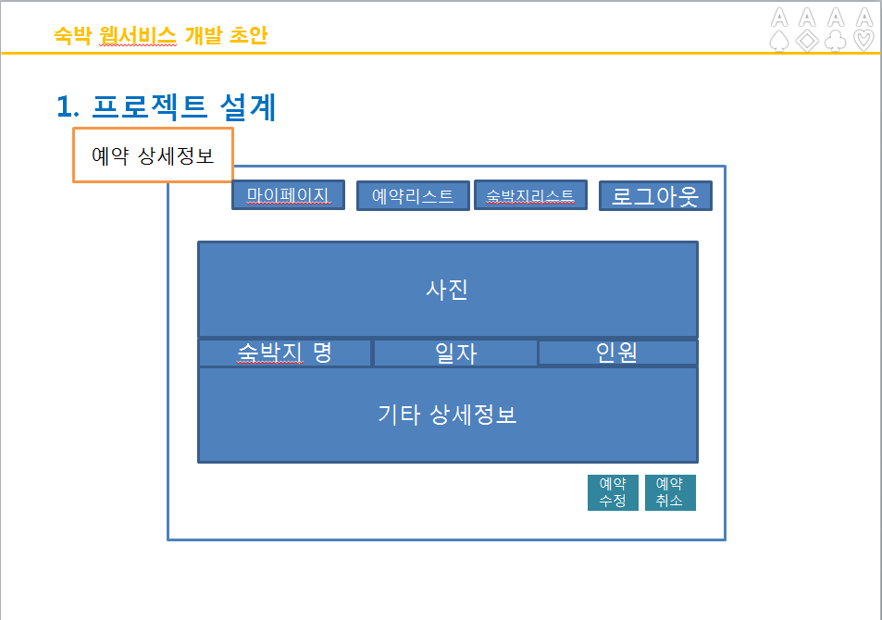
1. Yesterday’s Task
Result
UI Design

Slide 8
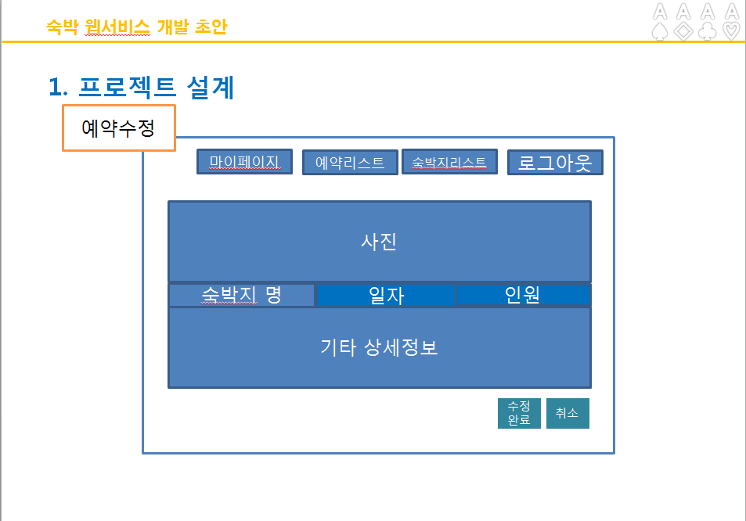
1. Yesterday’s Task
Result
UI Design

Slide 9
Yesterday’s Task
Today’s Task
Technical Issue

Slide 10
2. Today’s Task
ToDo
Bitbucket시작 및 개발환경세팅

Slide 11
Yesterday’s Task
Today’s Task
Technical Issue

Slide 12
3. Technical Issue
Issue
없음

Slide 13
END

